Slide 1
A guide to economic indicators and their impact on investing
J.P. Morgan Investment Academy Series
Notes:
Economic indicators always have been important road signs for economists and market analysts.
But in the last few years, they also have become far more important to portfolio managers, financial planners, advisors, and their clients.
Why? Because good news has never been more anticipated by so many. Even the slightest sign of improvement can signal the beginning of a turnaround, or a change in direction for the economy.

Slide 2

Reading the signs
Economic indicators are the road signs of market trends and conditions ahead.
Economic growth
Jobs
Turnaround indicators
Notes:
There are literally hundreds of economic indicators that help us try to make sense of the economy. Some are snapshots of current data, while others track trends that may potentially signal early signs of an economic or market turnaround.
The idea of estimating our national income and productivity originated in the 1930s when the lack of reliable economic data frustrated the efforts of Presidents Hoover and Roosevelt.
Over the years, as the economy has changed, our economic statistics have improved and accounting methods have had to adapt to maintain their relevance.
Today, I’d like to review some of the most important ones. Our quarterly Guide to the Markets tracks many of these indicators and I’ll be using examples of charts and graphs from the most recent issue to explain them and their relevance to investing.

Slide 3
Defining the term “economic indicator”
Economists and investors use a wide range of indicators to forecast or interpret the market.
Consumer price index
Key economic indicators
Gross domestic product
Price of crude oil
Notes:
But first, let’s take a minute and define economic indicators. [solicit audience participation: anyone care to help me out?]
An economic indicator is nothing more than an observation, typically a piece of economic data, that is used by economists and others to assess the health of the economy and to forecast or interpret investment opportunities and possibilities.
Economic indicators can potentially be anything an investor chooses – some people watch the sale of thoroughbred horses; others pay close attention to the sale of expensive jeans; or follow the daily moves of the Standard & Poor’s 500 Index; maybe you’ve even heard of the Super Bowl Indicator that theorizes if the NFC wins the Super Bowl, it’s a good year for stocks.
Let’s face it, if there were a crystal ball – or a single indicator that could predict market direction or opportunities, we’d all be doing something else. Even Alan Greenspan once said that being Fed chairman taught him “to mumble with great incoherence.”
Most economists pay attention to widely followed data released by government and non-profit organizations. These would include statistical reports that you hear quoted regularly such as the Consumer Price Index, Gross Domestic Product or the price of crude oil. Individually, they might not tell you much – but together, you can get a pretty good sense of what’s going on in the economy.

Slide 4
Leading, lagging and coincident indicators
Each indicator plays a different role in understanding the economy.
Leading indicators
Help to predict what the economy or a particular market will do in the future.
Lagging indicators
Confirm the trends or patterns that leading indicators predict. The unemployment rate, for example, is a lagging indicator.
Coincident indicators
Mirror what the data are saying — what’s happening right now.
Notes:
A leading indicator can help predict future economic activity – a good example is the Consumer Sentiment Index, which we’ll discuss momentarily; The stock market itself, represented by the Standard & Poor’s 500 Index is a leading indicator, as are bond yields, as traders and investors infer certain things and speculate trends in the economy.
Changes in the economy usually occur before they present themselves in what are called lagging indicators; these road signs typically confirm trends – and a good example would be unemployment claims.
Coincident indicators report current economic variables; examples would include the Gross Domestic Product (GDP) report and the Personal Income and Outlays report (specifically the personal income statistics).

Slide 5

Measuring the Gross Domestic Product (GDP)
The GDP expresses the value of all goods and services made, sold and exported during the reporting period.
Single most important indicator used to assess economic growth
Nominal GDP vs. Real GDP
Nominal GDP expresses value in current prices
Real GDP is adjusted for price inflation
Calculating real GDP growth enables economists to determine if production increased or decreased, regardless of changes in the purchasing power of the currency
Published quarterly by the U.S. Dept. of Commerce, Bureau of Economic Analysis
Notes:
There are several measures of economic growth. You can look at Consumer Spending reports, Corporate Profits, or even the esoteric Baltic Dry Index – which tracks the shipping rates to move raw materials like iron ore, grains, coal, and cement by sea. Each of those would give you a sense for how the economy is faring.
But the Gross Domestic Product report is the most comprehensive, and perhaps the single most important indicator used to assess the growth of the economy.
Gross Domestic Product, or GDP, for short, expresses in a single number the value of all goods and services made, sold and exported during the reporting period. It is published quarterly by the U.S. Department of Commerce, Bureau of Economic Analysis – and is updated monthly. And, in case you were wondering, economic growth in other countries is measured the same way, today.
We look at GDP two ways – with and without the impact of inflation; and each view has a name. You may have heard the terms "real" GDP growth or "nominal" GDP growth and wondered what the difference was.
-- Nominal GDP measures the value of all the goods and services produced expressed in current prices.
-- Real GDP, on the other hand, is adjusted for the rate of price inflation

Slide 6
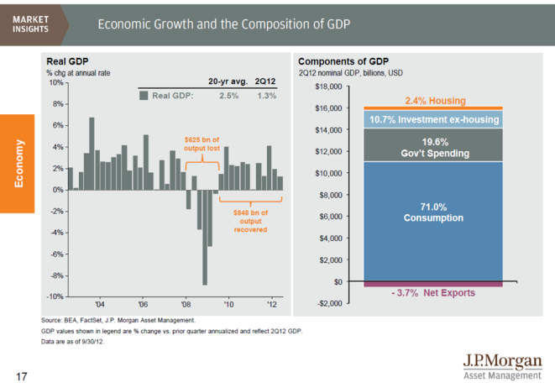
Using GDP as a forecast tool
While rising GDP indicates economic growth, falling GDP indicates potential recession.
Notes:
This is an illustration from our quarterly Guide to the Markets publication that tracks GDP over several years – each bar representing the economy’s quarterly productivity.
How do we use this GDP information? First of all, whether we’re looking at the U.S. or any other country, GDP gives us a way to measure whether a single nation’s economy is growing or shrinking. As you can see in the bar chart on the left, economic activity ebbs and flows, year in and year out, with seasonal, business and economic cycles. The cluster of bars on the right shows how the U.S. economy emerged from the recession after 2009.
Rising GDP indicates economic growth. Falling GDP indicates retrenchment.
Negative GDP growth for two or more consecutive quarters defines a recession
Professionals read these trends carefully to forecast recession or expansion, or to compare one economy to another to make a geographic allocation choice.
We like to look at the visual map to see where real GDP has been over five, 10 years or longer. Our analysts and economists may infer certain conclusions from such information.

Slide 7
Drilling down to the components of GDP
Economists study the shifting categories of GDP to better understand the economy.
Notes:
Turning our attention to the chart on the right…this illustration shows the composition of GDP – housing, consumption, business and government expenses, investment and net exports. And while GDP is not a perfect number, it is an extremely reliable proxy for economic growth.
This chart is published every quarter in our Guide to the Markets, and it’s worthwhile to watch how elements shift, ever so slightly, from quarter to quarter. Economists drill down and study many of the individual factors that make up each of these categories to better understand the economy.
Consumption is the largest component of GDP and seeks to measure what people are buying – these would include:
Durable goods: big-ticket items
Nondurable goods: food, clothes
Services: haircuts, medical care, insurance
Investment and government spending typically comprise about a third of the nation’s GDP. What government spends is a significant piece of the pie and includes expenses related to education, defense and police protection.
Of course, Washington and policy makers also pay close attention to GDP movements, and may trigger monetary policies to slow or accelerate economic growth.

Slide 8

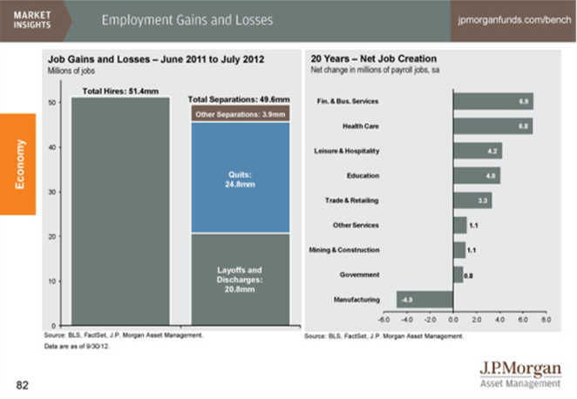
Analyzing the outlook for jobs
Jobless Claims is a leading economic indicator for assessing unemployment.
Notes:
An important measure of any economy is the number of jobs it produces.
To assess the employment picture we primarily look at three key indicators published by the U.S. Labor Department. These include: jobless claims, civilian unemployment and non-farm payroll. The department’s Bureau of Labor Statistics is the principal fact-finding agency for the Federal Government in the broad field of labor economics and statistics.
Earlier we talked about the difference between leading and lagging indicators. Jobless Claims is a leading indicator; this valuable, real time report is published weekly and includes the number of Americans who filed for unemployment benefits in the past week. Each state submits weekly unemployment information to a centralized database on Thursdays and the national figure is published on Fridays.

Slide 9
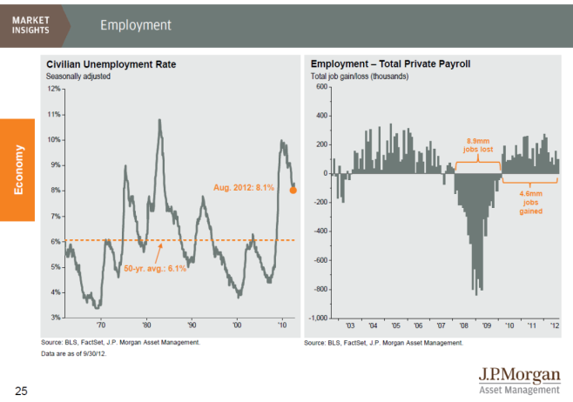
Assessing the larger unemployment picture
Consumer confidence and spending are closely linked to job market information.
Notes:
This illustration from our Guide to the Markets publication shows the Civilian unemployment rate since 1960, on the left, and monthly non-farm payroll gains and losses since 2001, on the right. We use this information to get a sense for the big unemployment picture – are companies hiring; what has changed from the prior period; how do the unemployment figures look relative to a longer-term average?
The Civilian Unemployment rate, measures the number of unemployed Americans as a percentage of the civilian labor force, that is, all workers excluding armed forces personnel. The statistics are derived from a monthly survey of approximately 60,000 households that is conducted by the Census Bureau for the Bureau of Labor Statistics.
The non-farm payroll report is derived from corporate payrolls, which accounts for about 80% of all U.S. workers. The statistic is reported on the first Friday of the month, and is used to assist government policy makers and economists determine the current state of the economy and predict future levels of economic activity. It excludes employees of government, private household, non-profit organizations that provide assistance to individuals and farm employees.
It’s true what they say about a picture being worth a thousand words, isn’t it? Look at the employment figures for the 2007 – 2010 period. An increase in unemployment or jobless claims could mean the economy is suffering; a decrease could mean that the economy is picking up. Negative numbers can lead to rising inflation and interest rates.
Job market information and household earnings are closely linked to and heavily influence consumer spending. When consumers feel confident about their jobs and household income, spending tends to rise – and, as you’ll recall from a previous slide, spending accounts for more than 2/3’s of the economy’s total output.

Slide 10
Gauging likely consumer spending
Consumer Sentiment is a lagging indicator that shows how consumers feel about the health of the economy.
Notes:
Consumer sentiment is a lagging economic indicator – and gives economists and analysts a sense for how consumers are feeling overall about the health of the economy and how likely they are to increase spending. It’s one of the most important indicators, because consumer spending is an essential component of any economy.
You can track sentiment against other indicators – like unemployment, sales of homes, cars and trucks, or the stock market.

Slide 11

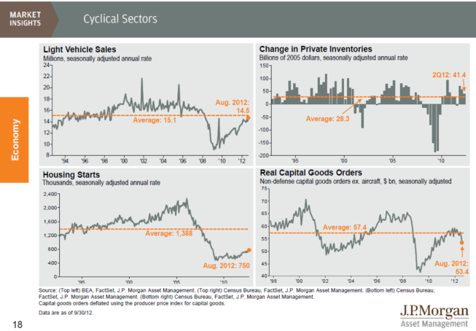
Tracking a potential turnaround
Increased housing starts and light vehicle sales may signal economic stabilization.
Notes:
Now let’s take a look at two indicators – housing starts and light vehicle sales – that continue to garner a lot of attention. They are considered to be “turnaround indicators.”
The graph in the upper left corner represents Light Vehicle Sales and includes the sales and leases of all domestic and imported new automobiles and light-weight trucks – and includes sales to consumers and businesses
While a relatively small component of the overall economy, changes in the lightweight vehicle sector often account for a large part of quarter-to-quarter changes in the rate of growth of GDP – because automobiles, both domestic and foreign, are a large component of the monthly consumption figures that go directly into the quarterly GDP calculations. The Light Vehicle Sales report is an important turnaround indicator because of the psychological and financial impacts of continued efforts to sustain U.S. automakers. Like housing, any sign of improvement in this area could significantly help consumer confidence.
Housing starts, the chart on the lower left, is considered a critical indicator of economic strength. Specifically, the Housing Starts report documents the number of new homes started during the previous month – including single family homes, 2-4 unit apartment buildings and buildings with five or more units.
Falling home sales and prices wreaked havoc on the mortgage-backed securities markets during the real estate crisis of 2008-2009. Any improvement in these numbers, which appear to be at an all-time low, is often viewed as an early sign of stabilization.
The other two charts on the right side of the page are also important as they track business activity in terms of inventory and capital goods orders – if inventories are low and demand increases, factories have to ramp up production; meanwhile, if companies are investing in new equipment – that’s a good sign that business is picking up.

Slide 12
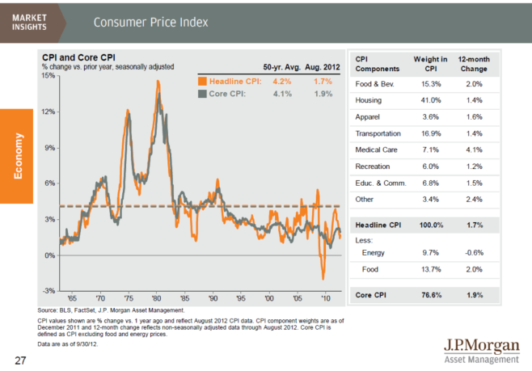
Measuring inflation with the consumer price index (CPI)
CPI is one of the most widely anticipated and watched economic indicators.
Notes:
The Consumer Price Index, or CPI, is another important economic indicator. Many other indicators derive most of their value from the predictive ability of the CPI, and it is widely anticipated and watched.
CPI plays a role in many key financial decisions, including Federal Reserve interest rate policy and the hedging decisions of major banks and corporations. Individual investors can also benefit from watching the CPI when making hedging and allocation decisions.
But CPI is also an important statistic to
This report often moves both equity and fixed-income markets, on the day of the release and on an ongoing basis. It may even set a new course in the markets for upcoming months. Analysts will be more sure of their convictions about what the Fed will do at the next Federal Open Market Committee meeting after digesting the Consumer Price Index.
The CPI report also is used to make adjustments to many cash flow mechanisms, like pensions, Medicare, cost of living adjustments to insurance policies, etc. As a result, most investors will find that the CPI affects them personally in some way. Fixed-income investors should always be aware of the rate of inflation against which they judge their investments; it is imperative to keep current yields ahead of inflation, or real wealth will fall.

Slide 13
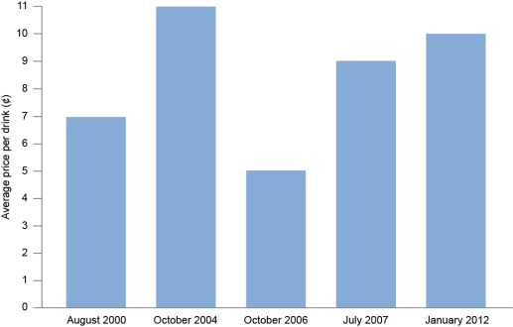
Understanding why CPI matters
Rising prices can affect investors and consumers differently.
Starbucks price increases, in average price per drink, since 2000 at company-owned U.S. stores.
Notes:
Let’s take a brief detour and talk about CPI for a minute – and why it matters as an economic indicator to consumers and investors.
If you are accustomed to buying a non-fat latte on a routine basis, you’ve noticed over the years that the price continues to inch up…and up…and up. In fact, the price has risen nearly every year since 2000 – and in some regions of the country the price increases are even more pronounced than in others.
Typically the price increases are due to increasing supply chain costs. For example, weather can wreak havoc on the coffee bean harvest and influence the supply/demand balance; other times it’s because of the increase in the cost of fuel – which gets passed on to consumers in the form of a couple of pennies per cup. Sometimes the price increases are regional due to the cost of local milk expenses or minimum wage increases in various states.
You could think of a Starbucks non-fat latte as an economic indicator with a high correlation to inflation. As a stockholder, you’d be glad to see the company responding to increased costs to produce their product by increasing their price – but as a consumer, you might decide to buy fewer latters each month. If you’re a stock analyst, you’re looking at these variables when you decide to buy, sell or add to your Starbucks position.

Slide 14
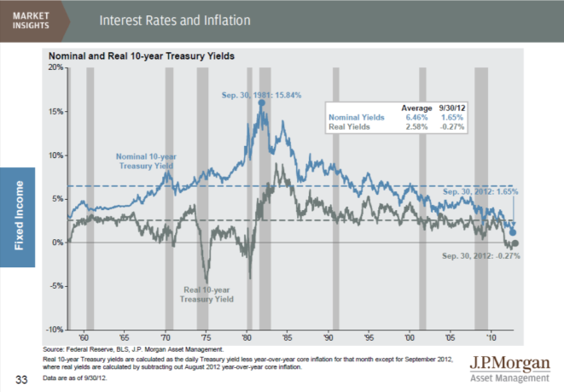
Assessing the impact of interest rates on inflation
While the stock market typically reacts negatively to rising interest rates, the bond market can have mixed reactions.
Notes:
The condition and direction of the U.S. economy is a major driver of interest rates and bond prices.
In this illustration from our Guide to the Markets, we observe the relationship between interest rates and inflation. While the Stock Market typically reacts negatively when interest rates rise, the Bond Market can have mixed reactions.
Even though no one knows what the future holds, bond traders profit when their expectations for the economy are correct. Bond market participants follow economic indicators closely, looking for signs of change that might affect future supply and demand so they can position themselves accordingly. When these indicators exceed or fall short of market expectations, bond prices can respond quickly and sharply.
Bonds are influenced by fears of inflation and expected total return. When interest rates rise, bond yields may increase, which can mean more income for bond investors. However, for current bond holders, the value of their bonds may fall, which could adversely affect their total return.
Earlier we talked about the nominal GDP vs. real GDP, which is adjusted for inflation. In this illustration, we consider nominal and real interest rates; today’s inflation rate exceeds the rate you would receive on a 6-month CD; in other words, an investor would lose money, or, purchasing power, if these rates persist.

Slide 15
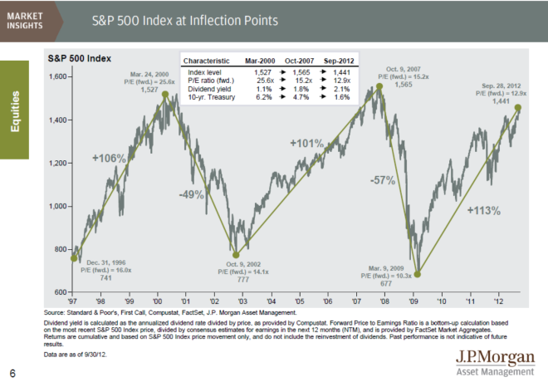
Summarizing our discussion
Greater knowledge of economic indicators leads to a better understanding of the economy and world markets.
Notes:
To summarize our discussion today, an economic indicator is any statistic that "indicates" how the economy is performing today and how it may be trending for the future.
Individually, none of the indicators we discussed today is a panacea – and no single report or data point is a trend. But together, and many of these indicators are interrelated, they shed light on what’s going on in the economy, and enable investors to make better, more informed decisions.
Economic indicators have the power to move financial markets and directly affect interest rates. One day, U.S. stocks are down because the Federal Reserve announces that economic growth has slowed in recent months. The next day, stocks are up because Apple announces its quarterly earnings beating analyst expectations – but bond prices are down because interest rates are up slightly. The following week both stock and bond prices are up because a report comes out that says the housing market is improving.
The more you know about economic indicators, the more confident you will become in understanding the economy and the world markets.

Slide 16
Disclosure
The above commentary is intended solely to report on various investment views held by J.P. Morgan Asset Management. Opinions and estimates offered constitute our judgment and are subject to change without notice, as are statements of financial market trends, which are based on current market conditions. We believe the information provided here is reliable, but do not warrant its accuracy or completeness. This material is not intended as an offer or solicitation for the purchase or sale of any financial instrument. The views and strategies described may not be suitable for all investors. This material has been prepared for informational purposes only and is not intended to provide, and should not be relied on for, accounting, legal or tax advice. References to future returns are not promises or even estimates of actual returns a client portfolio may achieve. Any forecasts contained herein are for illustrative purposes only and are not to be relied upon as advice or interpreted as a recommendation.
J.P. Morgan Asset Management is the marketing name for the asset management businesses of JPMorgan Chase & Co. Those businesses include, but are not limited to, J.P. Morgan Investment Management Inc., Security Capital Research & Management Incorporated and J.P. Morgan Alternative Asset Management, Inc.
© J.P. Morgan Chase & Co., December 2012

Slide 17
声明：
所有的版权属于原有公司，文件均来自公开渠道
此文件仅供学习使用，任何人不得进行以此为商业目的的行为
如有疑问，请立即删除
学习世界五百强和咨询公司PPT课程请访问如下网站搜索：“司马懿”
百度传课：司马懿PPT学校
https://www.chuanke.com
网易学堂：司马懿PPT学校
https://study.163.com
知乎： 司马懿PPT学校
https://www.zhiu.com

